Slide 1
DESCRIPTION OF SENSORS USED IN AISCM PROJECT
Suraj Padhy
Lasya vadapalli
Yashshree Patil
Rashmi Pawar

Slide 2
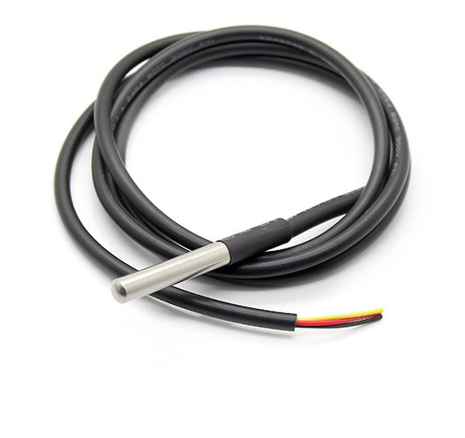
Temperature Sensor(DS18B20)
Sensor used: DS18B20 (Programmable Resolution 1-Wire Parasite-Power Digital Thermometer)

Slide 3
FEATURES
DS18B20 is a digital thermometer that provides 9-bit to 12-bit Celsius measurements.
It communicates over a 1-wire bus (single data line with single port pin) with the underlying Raspberry-Pi (microprocessor).
This sensor is powered directly from the data line also known as parasite power, thus eliminating the need of external power supply.(2 pins for this operation-DQ, GND)
Each DS18B20 sensor has a unique 64-bit serial code(stored in on-board 64 bit ROM) and hence this facilitates use of multiple DS18B20 sensors to be connected to the same 1-wire bus.
Measures temperatures from -55°C to + 125°C.
±0.5°C accuracy from -10°C to +85°C.
Contains a scratchpad memory- the R0 and R1 registers of the scratchpad memory store the digital output from the temperature sensor.

Slide 4
OPERATION: MEASURING TEMPERATURE
The resolution can be set to 9, 10, 11 or 12 bits which provide increments of 0.5°C, 0.25°C, 0.125°C and 0.0625°C respectively.(default at power-up is 12 bits). This resolution is set in the scratchpad register.
The T[44h] command has to be fired to initiate the measurement of temperature followed by analog to digital conversion.
After the conversion the resultant thermal value is stored in the scratchpad memory and the sensor returns to idle state.
The output temperature by DS18B20 is calibrated in degrees Celsius.
For Fahrenheit requirements either a look-up table can be maintained or can be converted using the Celsius to Fahrenheit conversion formula:
T(°F)=T(°C) * 9/5 + 32
The temperature data is stored as a 16-bit signed two’s complement number in the temperature register.
The signed bit indicates if the temperature is positive or negative.
The CRC byte (9th byte) is provided in the scratchpad memory which helps validate the data received.

Slide 5
TRANSACTION SEQUENCE:
INITIALIZATION
ROM COMMAND
FUNCTION COMMAND
A reset pulse is transmitted.
A presence pulse lets the bus master know about the presence of other slaves
Each slave sends it’s serial number for identification.
T[44h]: initiates single temperature conversion.
[4Eh]: allows master to write 3 bytes of data into scratchpad.
[BEh]: allows master to read contents of scratchpad.

Slide 6
ULTRASONIC SENSOR(HCSR04) SPECIFICATIONS
Measures distance from – 2 cm to 4 m.
Measuring angle – 15 degree.
Speed of wave – 340 m/sec(approx) , [accurate 342 m/sec]
Power supply +5V DC.
Input trigger signal – 10us ttl pulse.
Trigger pin when set to high emittes sound waves.
Echo pin senses the reflected wave and the time at which a wave is received by the echo is returned.
Operating frequency 40 KHz.

Slide 7
The Ultrasonic Sensor sends out a high-frequency sound pulse and then times how long it takes for the echo of the sound to reflect back. The sensor has 2 openings on its front. One opening transmits ultrasonic waves, (like a tiny speaker), the other receives them, (like a tiny microphone). The speed of sound is approximately 341 meters (1100 feet) per second in air. The ultrasonic sensor uses this information along with the time difference between sending and receiving the sound pulse to determine the distance to an object. It uses the following mathematical equation:
Distance = Time x Speed of Sound divided by 2
Time = the time between when an ultrasonic wave is transmitted and when it is received
You divide this number by 2 because the sound wave has to travel to the object and back.

Slide 8
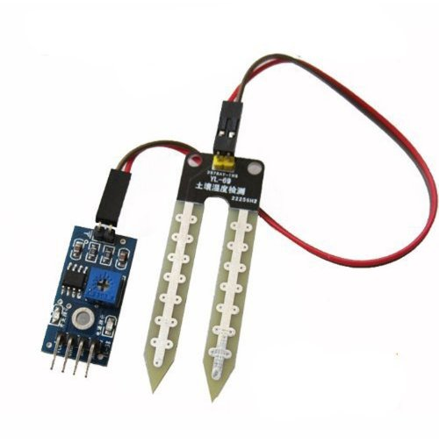
Soil Moisture Sensor (KG003)
Sensor used: KG003

Slide 9
FEATURES
Working voltage: 5V
Working Current: <20ma
Interface: Analog
Depth of detection: 37mm
Working Temperature: 1
Output voltage signal: 0 to 4.2V

Slide 10
OPERATION: MEASURING MOISTURE
Moisture Sensor uses the two probes to pass current through the soil, and then it reads that resistance to get the moisture level. More water makes the soil conduct electricity more easily (less resistance), while dry soil conducts electricity poorly (more resistance).
sensor gives us the value from 0-1023
The ADS1115 are great analog to digital converters that are easy to use with the Raspberry Pi using its I2C communication bus.
Gain will amplify signals so it's easier to read small weak signals.The gain also controls the range of voltages that can be read by the chip

Slide 11
Gain values:
2/3 = +/-6.144V
1 = +/-4.096V
2 = +/-2.048V
4 = +/-1.024V
8 = +/-0.512V
16 = +/-0.256V
The function takes one parameter, the channel number to read (a value of 0 to 3), and optionally a gain value (the default is 1).

Slide 12
Why do we use analog output of moisture sensor and convert it to digital while we already have a digital output at the sensor?
The sensor module contains a potentiometer with it, which is used to set the threshold value. this threshold value is then compared with the sensor output value using the lm393 comparator which is placed on the sensor module.
The lm393 comparator will compare the sensor output value and the threshold value and then gives us the output through the digital pin. when the sensor value will be greater than the threshold value, then the digital pin will give us 5v and when the sensor value will be less than this threshold value, then the digital pin will give us 0v. (output obtained will be high and low)
Therefore for a continuous output A0 (Analog output is used) and later converted to digital using ADC.

Slide 13
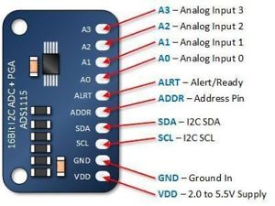
ADC ADS1115

Slide 14
Features of ADS1115
Ultra-small QFN package: 2 mm x 1.5 mm x 0.4 mm
Wide supply range: 2 V to 5.5 V
Programmable data rate: 8 SPS to 860 SPS
16 bit,I²C interface: pin-selectable addresses
Internal oscillator
Internal PGA(Programmable Gain Amplifier)
Programmable Comparator
Internal low-drift voltage reference

Slide 15
Operation
The ADS1115 is a 4-channel analog-to-digital converter utilizes the I2C protocol with selectable addresses.
The analog output of the sensor from pin A0 is given to A0 pin of ADC which is analog input pin.
For communication with Raspberry Pi the I2C pins must be enabled and then set to high.
ADS1115 has an Internal PGA(Programmable Gain Amplifier).We have to set gain of ADC depending on voltages that we want to read. Program gain is set to one to read voltage from 0V-4.09V. To read value from ADC read_adc() function is used.

